Slide 1

Bootstrap 4
By: Arturo Zamarripa

Slide 2
What is bootstrap?
Bootstrap is the most popular CSS Framework for developing mobile-first websites.
Bootstrap is a free open-source CSS Framework
Bootstrap 4 is the newest version of Bootstrap
Bootstrap 4 is supported by all major browsers except Internet Explorer 9.

Slide 3
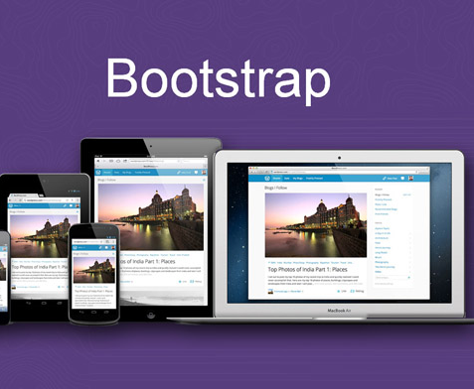
Responsive web design
Responsive Web design is the approach that suggests that design and development should respond to the user’s behavior and environment based on screen size, platform and orientation.

Slide 4
Where to get bootstrap 4
There is two ways to get Bootstrap 4.
First is using the Bootstrap 4 Content Delivery Network (CDN)
Second you could visit the getbootstrap.com website to download Bootstrap 4 to host it on your personal computer.

Slide 5
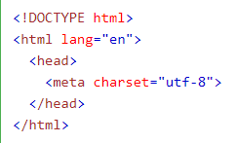
Bootstrap 4 – HTML5 Doctype
Bootstrap 4 uses HTML elements and CSS properties that require the HTML5 doctype.
Always include the HTML5 doctype at the beginning of the page, along with the lang attribute and the correct character set.

Slide 6
Bootstrap 4 – Mobile First
Bootstrap 4 is designed to be responsive to mobile devices. Mobile first
To ensure proper rendering and zoom, add <meta> tag inside the head element.
The width=device-width part sets the width of the page to the screen-width of the device
The initial-scale=1 sets initial zoom level when browser loaded.

Slide 7
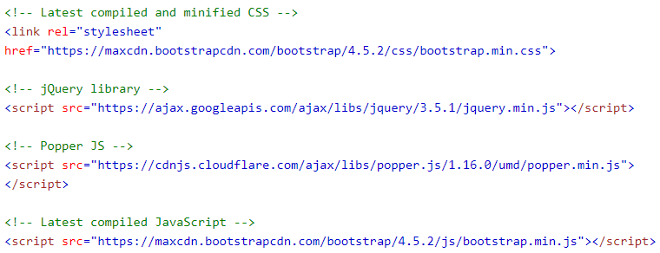
Bootstrap 4 - CDN
If you do not want to download and host Bootstrap 4, you must include the CDN (Content Delivery Network)
Include these line inside the <head> tags

Slide 8
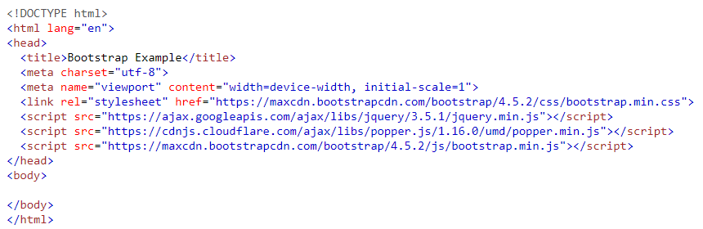
Bootstrap 4 - Progress

Slide 9

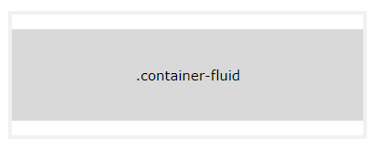
Bootstrap 4 – Containers
.container
.container-fluid
Provides a responsive fixed width container.
Provides a full width container, spanning the entire width of the viewport

Slide 10
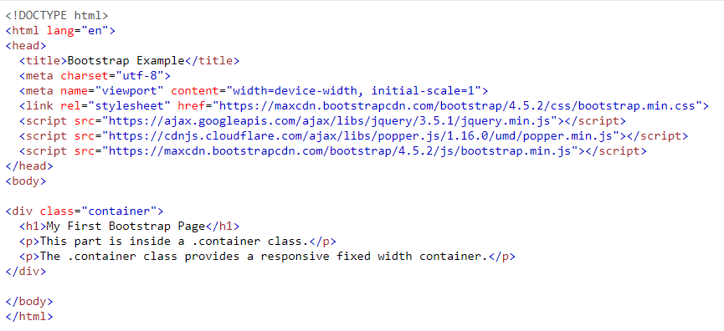
Bootstrap syntax

Slide 11
Bootstrap 4 – Container Formatting
pt-3 = sets top padding
p-3 = sets padding (all directions)
my-3 = sets margins
border = plain container border
bg-color = sets background color & color
text-color = sets text color

Slide 12
Bootstrap 4 - Colors
Text Color
.text-primary
.text-muted
.text-success
.text-warning
.text-info
.text-danger
.text-secondary
.text-white
.text-dark
.text-body (default color)
.text-light
Background Color
.bg-primary
.bg-success
.bg-info
.bg-warning
.bg-danger
.bg-secondary
.bg-dark
.bg-light

Slide 13
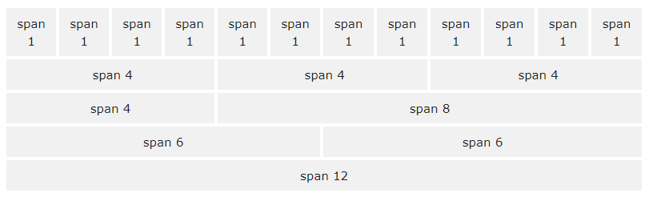
Bootstrap 4 Grids
Built with flexbox and allows up to 12 columns across the page.
If you do not want to use all 12 columns individually, you can group the columns together to create wider columns.
The grid system is responsive, and the columns will re-arrange automatically depending on the screen size.
Make sure that the sum adds up to 12 or fewer (it is not required that you use all 12 available columns).

Slide 14
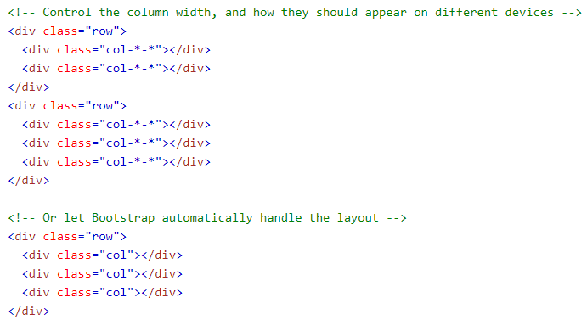
Grid Format

Slide 15

Bootstrap 4 - Jumbotron
Jumbotrons are used to bring extra attention to special content or information.
Use a <div> element with a .jumbotron to create a jumbotron
If you want rounded corners place a .jumbotron inside of the .container

Slide 16
Bootstrap 4 – Tables
.table class adds basic styling to a table
.table-striped class adds zebra-stripes to a table
.table-bordered class adds borders to a table and cells.
.table-hover class adds a hover effect on table rows
.table-dark class adds a black background to the table
.table-borderless class removes borders from the table

Slide 17
Bootstrap 4 – Icons & Images
https://fontawesome.bootstrapcheatsheets.com/# - icons for bootstrap
.rounded – adds rounded corners to an image.
.rounded-circle – shapes the image to a circle.
.img-thumbnail – shapes the image to a thumbnail (bordered).
.float-right – float image to the right.
.float-left – float image to the left.
.image-fluid – add this class to create a responsive photo.

Slide 18
Bootstrap 4 – Navbar
With Bootstrap. A navigation bar can extend or collapse, depending on screen size.
A standard navigation bar is created with the .navbar class, followed by a responsive collapsing class.
.navbar-expand-xl
.navbar-expand-lg
.navbar-expand-md
.navbar-expand-sm
Determines when a .navbar should stack vertically based on screen size.
To add links inside the navbar, use a <ul> element with class=“navbar-nav”. Then add <li> elements with a .nav-item class followed by an <a> element with a .nav-link class.

Slide 19
Bootstrap 4 – Navbar
You may want to hide the navigation links, especially on small screens, and replace them with a button. By pressing the button you will reveal the links.
To create a collapsible navigation bar, use a button with class=“navbar-toggler”, data-toggle=“collapse” and data-target=“#thetarget”. Then wrap the navbar contents inside a div element with class=”collapse navbar-collapse”, followed by an id that matches the data-target of the button: “thetarget”.

Slide 20
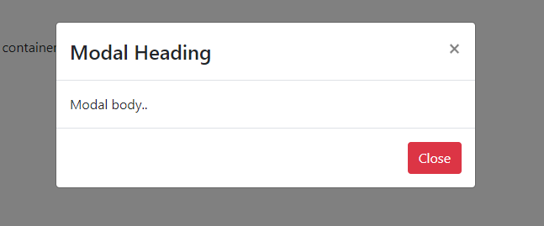
Bootstrap 4 - Modal

Slide 21
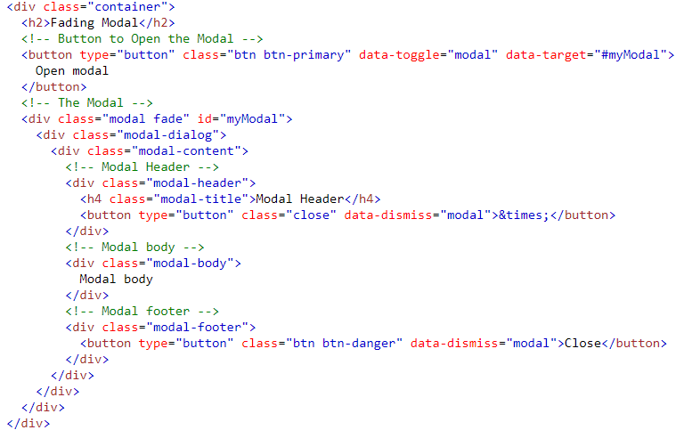
Bootstrap 4 – Modal
The Modal component is a dialog box/popup window that is displayed on top of the current page.

Slide 22
Where to Learn More About Bootstrap 4
https://getbootstrap.com/docs/4.0/getting-started/introduction/
https://www.w3schools.com/bootstrap4/default.asp

